Slide 1

Summer Internship 2016
Mentored by – Dr. Amit Chattopadhyay
Contour Tree
Presented by :-
Samarth Mishra
x---Date---x

Slide 2
Introduction
Many imaging technologies and scientic simulations produce data in the form of sample points with intensity Values.
Contour trees were proposed by van Kreveld et al for computing isolines on terrain maps in geographic information systems.
Isolines, often called contours, are the curves consisting of points at a given height that can be seen on any topographic map.
With terrain maps, a surface model is computed from elevation values at sample points in the plane.
Contours can be traced from a surface model relatively easily, given a starting point

Slide 3
Definition
The contour tree for a Morse function is dened as a graph in which:
each leaf vertex represents the creation or deletion of a component at a local extremum of the parameter
each interior vertex represents the joining and/or
splitting of two or more components at a critical point.
each edge represents a component in the level sets for all values of the parameter between the values
of the data points at each end of the edge.

Slide 4
Morse Theory
-> Morse theory studies the changes in topology of level sets of f as the parameter x changes. Points at which the topology of the level sets change are called critical points.
-> Morse theory requires that the critical points be isolated – i.e. that they occur at distinct points and values.
-> A function that satisfies this condition is called a Morse function. All points other than critical points are called regular points

Slide 5
Abstract
The Contour Tree is a data structure that represents the relations between the connected components of the level sets in a scalar field.
Two connected components that merge together (as one continuously changes the isovalue) are represented as two arcs that join at a node of the tree.
The first efficient technique for Contour Tree computation in 2D was introduced by de Berg and van Kreveld. O(n log n)
Recently Carr,Snoeyink and Axen presented an elegant extension to any di-mension based on a two-pass scheme that builds a Join Tree and a Split Tree that are merged into a unique Contour Tree. O(m + n log n)

Slide 6
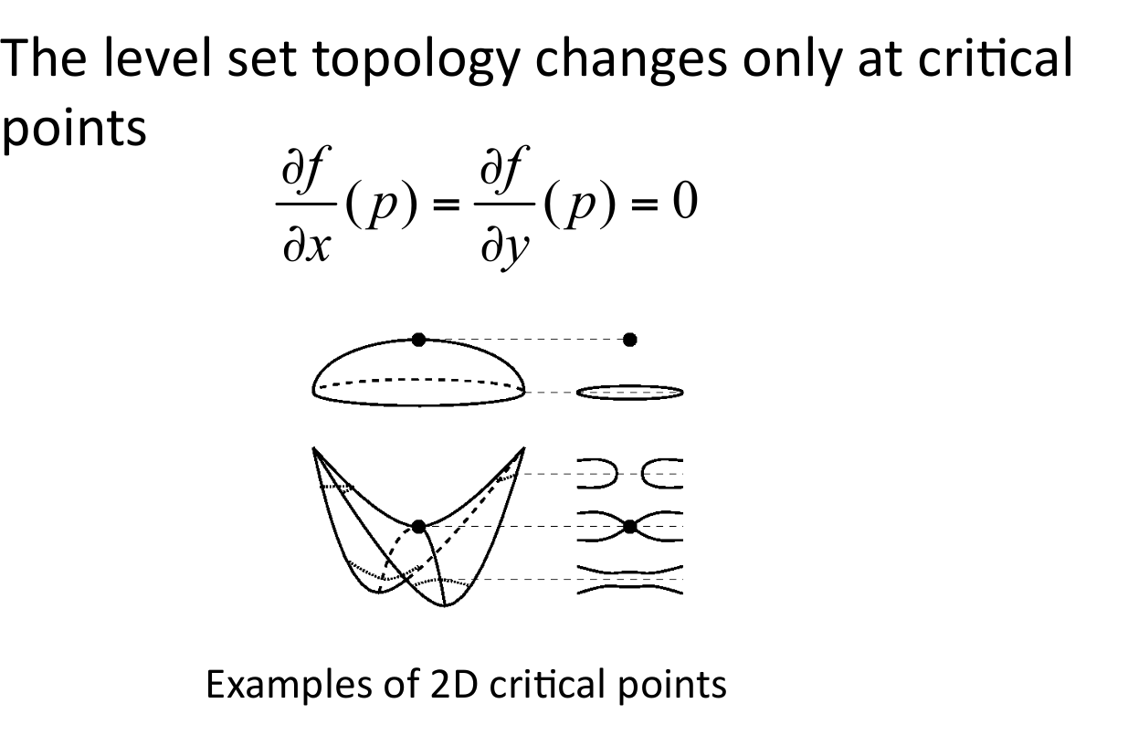
Critical Points and Topology
The points where the topology of the contour changes are called critical points.

Slide 7
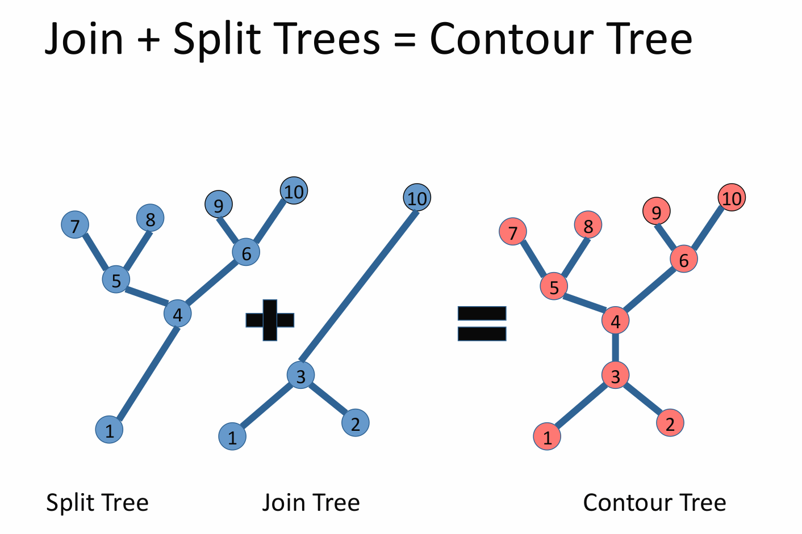
Contour Tree

Slide 8
Algorithm
Divide and Conquer
The basic idea is to compute Join/Split Trees by recursively combining the same trees computed for two halves of the mesh.
This approach allows one to achieve better modularity by confining any knowledge of a specific interpolant to an oracle (that is an independent external function) that computes the tree for a single cell.
In our analysis of the scheme we show a time complexity of O(n + t log n), where t is the number of critical points in the field.
Algorithm is easily parallelizable – good scalability with the number of processors.

Slide 9
Stages of the Algorithm
Sorting of the vertices in the field
Computing the Join Tree
Computing the Split Tree
Merging the Join Tree and Split Tree to build the Contour Tree

Slide 10
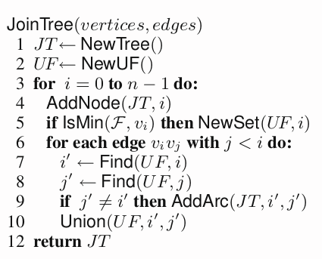
Join Tree

Slide 11
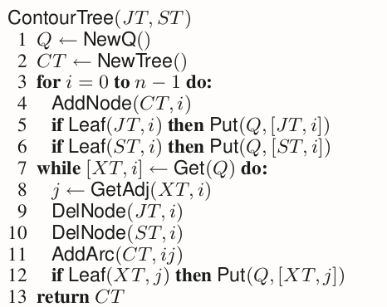
Contour Tree

